Slide 1
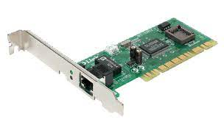
Function of network Interface card(nic)
DEFINITION:-
A network interface card (NIC) is a hardware component, typically a circuit board or chip, which is installed on a computer so it can connect to a network.
The NIC uses the OSI model to send signals at the physical layer, transmit data packets at the network layer and operate as an interface at the TCP/IP layer.
Every NIC has a 48-bit unique serial number called a MAC address which is stored in ROM carried on the card.

Slide 2
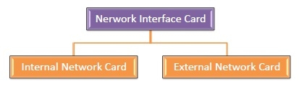
Types of NIC Cards
NIC cards are of two types −
Internal Network Cards
External Network Cards

Slide 3
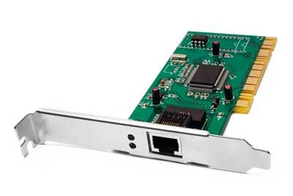
Internal Network Cards
DEFINITION:-
In internal networks cards, motherboard has a slot for the network card where it can be inserted.
It requires network cables to provide network access.
This type of NIC is most widely used in the LAN, MAN, and WAN networks.

Slide 4
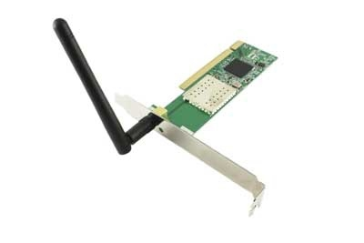
External interface card
DEFINITION:-
It is a wireless network that allows us to connect the devices without using the cables.
These types of NICs are used to design a Wi-Fi connection.

Slide 5
Functions of nic
Functions of the Network Interface Card is given below -
NIC is used to convert data into a digital signal.
In the OSI model, NIC uses the physical layer to transmit signals and the network layer to transmit data packets.
NIC offers both wired (using cables) and wireless (using Wi-Fi) data communication techniques.
NIC is a middleware between a computer/server and a data network.
NIC operates on both physical as well as the data link layer of the OSI model.

Slide 6
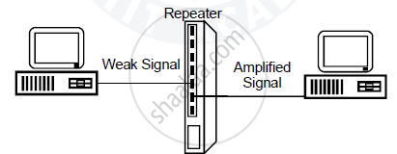
repeater
DEFINITION:-
Repeaters are network devices operating at physical layer of the OSI model that amplify or regenerate an incoming signal before retransmitting it.
They are incorporated in networks to expand its coverage area. They are also known as signal boosters.

Slide 7
types of repeater
According to the types of signals that they regenerate, repeaters can be classified into two categories −
Analog Repeaters − They can only amplify the analog signal.
Digital Repeaters − They can reconstruct a digital signal.
According to the types of networks that they connect, repeaters can be categorized into two types −
Wired Repeaters − They are used in wired LANs.
Wireless Repeaters − They are used in wireless LANs and cellular networks.

Slide 8
Advantages of repeater
Repeaters are simple to install and can easily extend the length or the coverage area of networks.
They are cost effective.
They can connect signals using different types of cables.

Slide 9
Disadvantages of repeater
Repeaters cannot connect dissimilar networks.
They cannot differentiate between actual signal and noise.
They cannot reduce network traffic or congestion.
Most networks have limitations upon the number of repeaters that can be deployed.

Slide 10
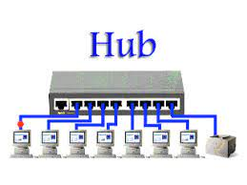
Hub
DEFINITION:-
A hub is a common connection point, also known as a network hub, which is used for connection of devices in a network.
A hub has no routing tables or intelligence (unlike a network switch or router), which is used to send information and broadcast all network data across each and every connection.

Slide 11
Types of hub
Passive hubs
Active hubs
Intelligent hubs

Slide 12
Passive Hubs − Passive hubs connects nodes in a star configuration by collecting wiring from nodes. They broadcast signals onto the network without amplifying or regenerating them. As they cannot extend the distance between nodes, they limit the size of the LAN.
Active Hubs − Active hubs amplify and regenerate the incoming electrical signals before broadcasting them. They have their own power supply and serves both as a repeater as well as connecting centre. Due to their regenerating capabilities, they can extend the maximum distance between nodes, thus increasing the size of LAN.
Intelligent Hubs − Intelligent hubs are active hubs that provide additional network management facilities. They can perform a variety of functions of more intelligent network devices like network management, switching, providing flexible data rates etc.

Slide 13
Advantages of hub
It provides support for different types of Network Media.
It can be used by anyone as it is very cheap.
It can easily connect many different media types.
The use of a hub does not impact on the network performance.
Additionally, it can expand the total distance of the network.

Slide 14
Disadvantages of hub
It has no ability to choose the best path of the network.
It does not include mechanisms such as collision detection.
It does not operate in full-duplex mode and cannot be divided into the Segment.
It cannot reduce the network traffic as it has no mechanism.
It is not able to filter the information as it transmits packets to all the connected segments.
Furthermore, it is not capable of connecting various network architectures like a ring, token, and ethernet, and more.

Slide 15
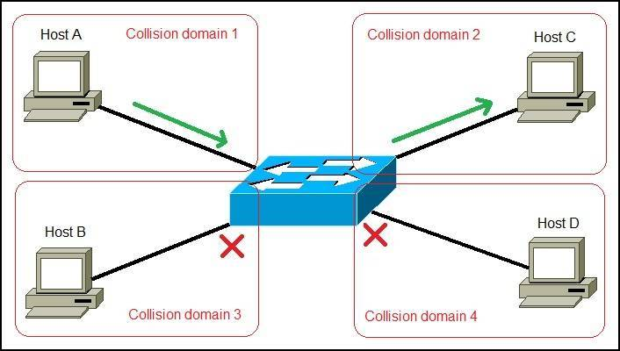
switches
DEFINITION:-
Switches are networking devices operating at data link layer of the OSI model. They connect devices in a network and use packet switching to send, receive or forward data packets or frames over the network.
A switch has many ports. When a data frame arrives at any port of a network switch, it examines the destination address, performs necessary checks and sends the frame to the corresponding device. It supports unicast, multicast as well as broadcast communications.

Slide 16
Advantages of switches
Switch increases the bandwidth of the network.
It reduces the workload on individual PCs as it sends the information to only that device which has been addressed.
It increases the overall performance of the network by reducing the traffic on the network.
There will be less frame collision as switch creates the collision domain for each connection.

Slide 17
Disadvantages of switches
A Switch is more expensive than network bridges.
A Switch cannot determine the network connectivity issues easily.
Proper designing and configuration of the switch are required to handle multicast packets.

Slide 18
THANK YOU

